Slide 1
How to create login

Slide 2
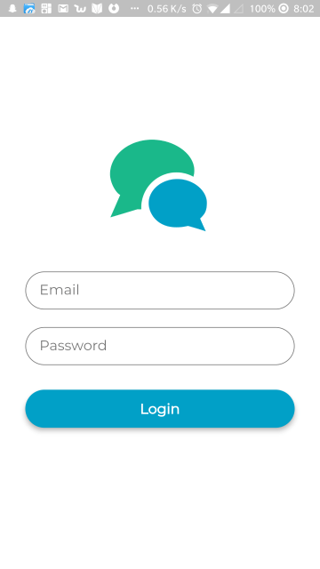

Slide 3
pubspec.yaml

Slide 4
Build the UI
import 'package:flutter/material.dart';
Among those are the MaterialApp, Scaffold, and AppBar widgets that we’re using inside our app. The methods that we’re using are either part of a library you’ve imported, or part of the Flutter framework itself.

Slide 5
runApp method
This is the entry point of our whole program so it must always be
defined if you want to render something on the screen
=> Support for constants (also known as "immutable variables"), i.e.,
variables which cannot be re-assigned new content. Notice: this only makes the variable itself immutable, not its assigned content (for instance, in case the content is an object, this means the object itself can still be altered).

Slide 6
Then we define our MyApp widget. Amend your MyApp class like the following (only change the title property) :

Slide 8
The code above returns a new MaterialApp widget defining our app title, our app theme, and our home page
As you can notice, it is a stateless widget. To create a stateless widget, you need to extend the StatelessWidget class like the following:

Slide 9
Now we’ll define our home widget, this time it is a stateful widget, this means it will contain fields that affect how it looks.

Slide 10
The following class will be responsible for defining our MyHomePage widget state.

Slide 15
Inside the body of the class, we need to override the build function that returns our main widget. We then define our UI elements, two text fields and a login button:

Slide 16
emailField:

Slide 17
The final keyword simply tells our app that the object value won’t be modified throughout the app. We define an input using the TextField widget, we added a hint,some style and decoration. We use some padding for adding an empty space inside the surrounding area of the field. We add a borderRadius to have a fancy rounded input field

Slide 18
passwordField

Slide 19
The definition of the password field is almost the same as the previous one, except that we add a property obscureText: true to hide input as we are typing, like a password field should behave.

Slide 20
loginButton

Slide 21
We use the Material widget to add easily a shadow(elevation ) to our button. We also add a radius to have a rounded button. Last we add a button as a child our material widget which also take a Textwidget as a child. Our button has an onPressed property that takes a function called whenever it is clicked.

Slide 22
After that we put all these widgets together inside our Scaffold widget. Our form elements are aligned vertically inside a Column widget. Generally, we use the SizedBox widget just for spacing purposes. We add an our image inside a SizedBox in order define a height for it

